Slide 1
Commanding the Command Line
Cybersecurity
Lesson 3.3

Slide 2

By the end of today’s class, you will be able to:
1
Explain how options modify the default behavior of a terminal command.
2
Use the man command to list instructions and options for each command.
3
Use the find command to locate files based on search parameters.
4
Use the grep command to search within the contents of files.
5
Combine multiple commands in sequence with pipes for intermediate IT tasks.

Slide 4

Warm-Up
Continue in your role as a security analyst at Candy Corp.
Candy Corp's management apprehended Ruth and Henry, and they're grateful for all your work so far.
The local authorities have video evidence that Sugar Corp delivered a cash payment to Candy Corp's back door on October 13, 2019.
You are tasked with gathering physical access logs to prove Henry or Ruth opened the back door for the delivery.
15 Minutes

Slide 7

The find Command

Slide 8

The find Command
Looking for our files
Using cd to navigate the file structure is time consuming.
As a cybersecurity professional, you often are not given the location to:
  User files
  Logs
  Configuration files

Slide 9

The find Command
Will
Will not
However, find does not review the contents within a file; it only reviews the file name or directory name.
The find command searches for files and directories with one command.
☑
☒
By default, find will search through the current directory and the subdirectories within that current directory.

Slide 10

find Syntax
This command finds all files.
find -type f
The option -type and required parameter f indicate that we are searching for files.

Slide 11
find Syntax
This example finds a specific file.
find -type f -name log.txt
The option -name searches for an exact match of the specified parameter log.txt.

Slide 12
find Syntax
Finding a file with case insensitivity, change the -name option to -iname.
find -type f -iname log.txt
This will find the files called log.txt (lowercase) or LOG.TXT (uppercase).

Slide 13
find Syntax
The symbol known as a wildcard searches for all files ending with .txt.
The * wildcard symbol indicates that any file ending with .txt will be displayed regardless of what comes before .txt.
find -type f -iname `*.txt`
With the addition of -iname, this example finds all files that end with
.txt or .TXT in your current directory and its subdirectories.

Slide 14
find Syntax
Search for a file located in another directory.
Specifically, we’re looking for the case-insensitive log.txt in the /root/desktop directory.
find /root/desktop -type f -iname `log.txt`
Place the desired directory after the find command and before the the -type option.

Slide 15
Syntax for Finding a Directory
Add d as the parameter for the option -type.
find -type d
find -type d -name logs
find -type d -iname logs
find -type d -iname `*1013`
find /root/desktop -type d -iname logs

Slide 16



Demonstration Scenario
Your manager at ACME Corp has tasked you with finding logs for a certain type of web server called Apache for the date of October 13.
The directory should be named apache and the log files should have the date noted as 1013 in their file names.
Since there are many directories, you will use the find command to complete these tasks.
Notes:
shutterstock_1888488028

Slide 17

Instructor Demonstration
find

Slide 18
Demo Summary
find simplifies the searching process
find | Command-line command used to locate a file or directory
type f | An option used to find files
type d | An option used to find directories
name | Additional option used to find specific file of directory names
iname | Additional option used to find case-insensitive names

Slide 19
find Your Way
Continue in your role as a security analyst at Candy Corp.
Your manager has identified why PeanutButtery.net was targeted: Henry had hidden a secret recipe for a revolutionary candy within the file system, and Sugar Corp was trying to find it.
Your manager at Candy Corp needs you to search through the files and file directories of the PeanutButtery.net server to find the hidden recipes in its file system.
20 Minutes

Slide 23
The grep Command

Slide 24
The find command only searches for the names of files, not the contents.

Slide 25

grep
global regular expression point is used to search for data inside files.
grep by default:
Returns the entire line that the desired data is found
Only searches for data in the current directory

Slide 26

grep Syntax
In this example, grep finds the lines in which user bob is mentioned in the file log1.txt.
<grep data_point File_to_search_inside>

Slide 27
grep Syntax
Use grep to find a specific data point within a single file.
Command
The file being searched for the data point
grep bob log1.txt
The specific data point searched for
This command displays all the lines where the data point bob was found inside the
file log1.txt. If no matches of bob are found in the file, nothing is returned.

Slide 28
grep Syntax
Use grep to find a specific data point within multiple files.
Find where bob exists in all .txt files.
bob is the specific data point being searched for.
* indicates that it will search through all files that end with .txt.
The command will display all the .txt files where the value of bob was found, followed by the lines where it was found.
grep bob *.txt

Slide 29
What does this command do?
grep -i bob *.txt

Slide 30
grep Syntax
Find a case-insensitive specific data point.
This command finds the line where the user bob or BOB exists within all .txt files.
grep -i bob *.txt

Slide 31
grep Syntax
Find a filename containing a specific data point.
This command outputs the file names of .txt files containing bob or BOB.
Note: -il are two separate options.
i indicates case insensitivity.
l indicates to only return the file name.
i and l use a single hyphen.
grep -il bob *.txt

Slide 32

Demonstration Scenario
Your manager asks for your help with a security investigation into an illegal money transfer that took place on May 17.
They tell you the suspect, Sally Stealer, stated that she never logged in to the company's banking website and definitely did not transfer any money on May 17.
You must use the grep command to search the application logs to see if Sally Stealer logged in on that day and, if so, whether she transferred any funds.
Notes:
shutterstock_1888488028

Slide 33
Instructor Demonstration
grep

Slide 34

Demo Summary
grep is used to find data points within a file
Basic syntax:
i indicates case insensitivity.
l indicates to only return the file name.
grep data_point file_to_search

Slide 35
grep
Continue in your role as a security analyst at Candy Corp.
Your manager found out that Sugar Corp recently made a large purchase of guavaberries. Sugar Corp currently does not have any candy that includes guavaberries, but Candy Corp does.
Your manager suspects that Sugar Corp is trying to reproduce some of Candy Corp’s secret recipes that use guavaberries.
Your task is to determine which of the secret recipes contain guavaberries in their list of ingredients.
20 Minutes

Slide 38

Combine Commands with Piping

Slide 39



Terminal Review
Commands we’ve discussed for working with files:
find
grep
wc
Searches for data points inside files
Counts lines or words inside a file
Searches for file names or directories

Slide 40
Security professionals are often tasked with combining commands to complete certain tasks.

Slide 41
Pipes
Use pipes to combine commands in a single line.
Redirects the output of commands to another to complete additional tasks
Designated by the symbol: |
Multiple can be used in a single command
Process data flows from left to right

Slide 42
stdin and stdout are our most common data streams to handle data.

Slide 43
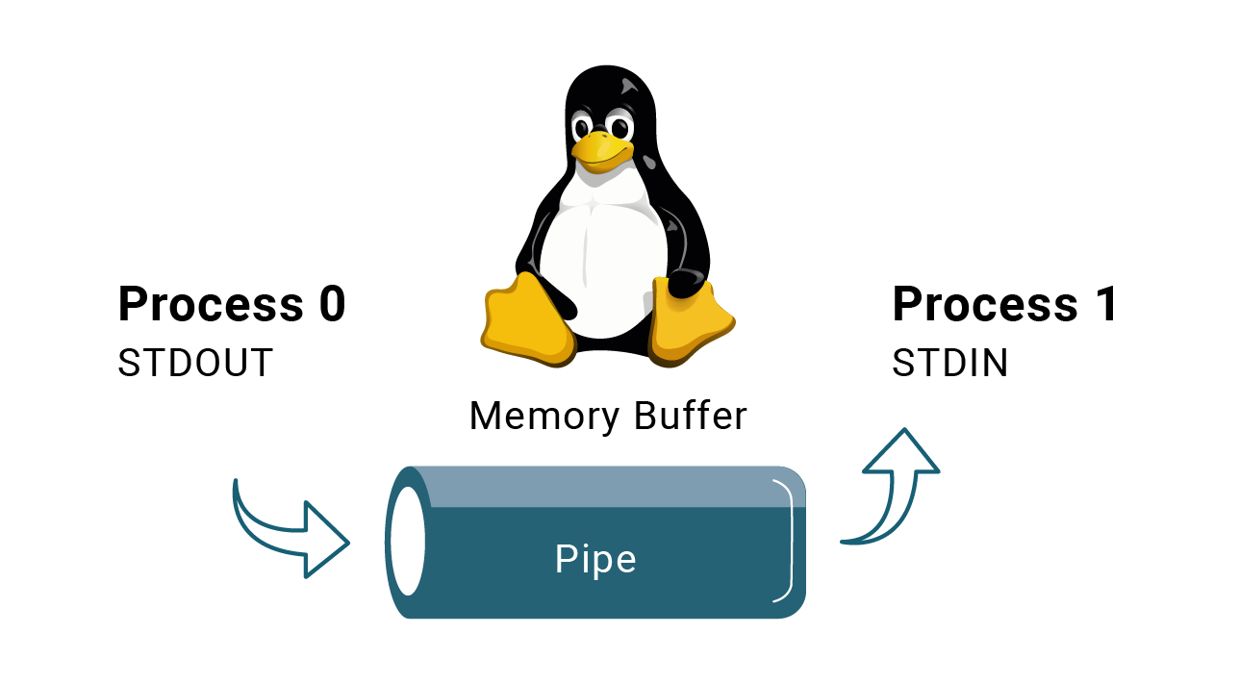
Combine Commands with Piping
Pipes are used with data streams

Slide 44

Demonstration Scenario
Your manager has tasked you with continuing the investigation against Sally Stealer. They believe she may have transferred other large amounts of money.
Your manager created a single file called largetransfers.txt that contains all transfers over one million dollars.
Your manager asks you to count how many of those transfers belong to Sally Stealer.
Notes:
shutterstock_1888488028

Slide 45
Instructor Demonstration
Pipes

Slide 46
Demo Summary
Pipes redirect the output of a command to another
01
A pipe is designated with the | symbol.
02
Multiple pipes can be used in a single command.
03
Pipes are unidirectional, meaning the processing of the data flows from left to right through the pipeline.

Slide 47
Gather Evidence
Continue in your role as a security analyst at Candy Corp.
Candy Corp believes it has enough evidence to send to the authorities to charge Sugar Corp with a cyber crime.
Your task is to gather several points of evidence from your file systems that can be provided to the authorities to prove that Sugar Corp is stealing data.
20 Minutes

Slide 50
We will learn about permissions, file ownership, and access controls.

